Slide 1
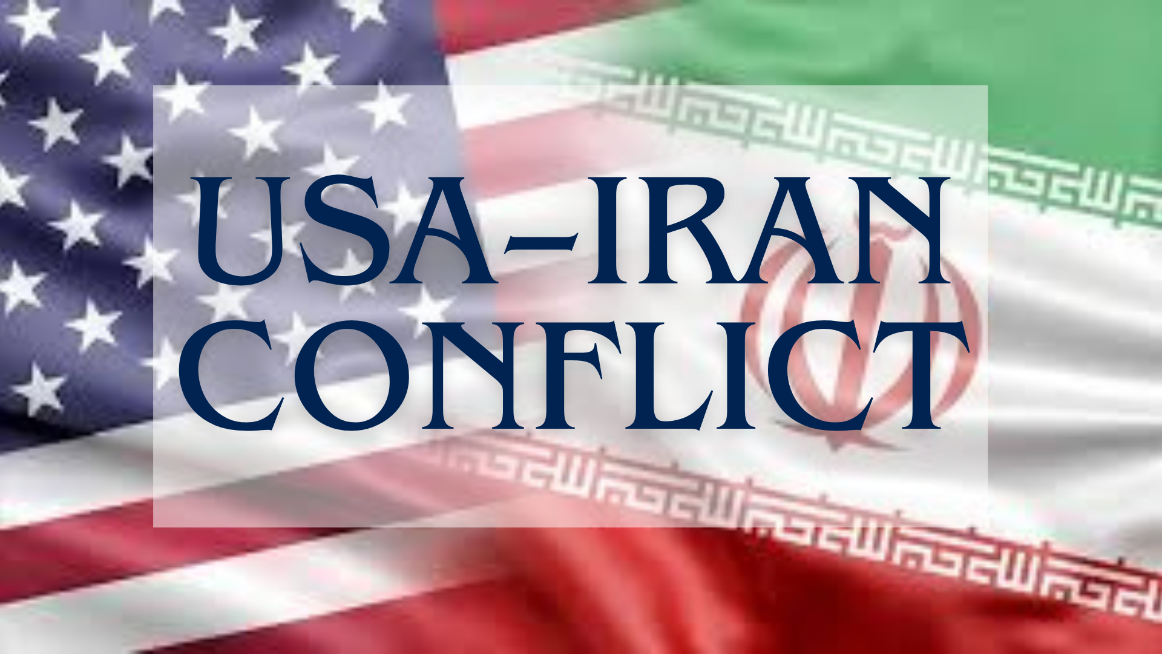
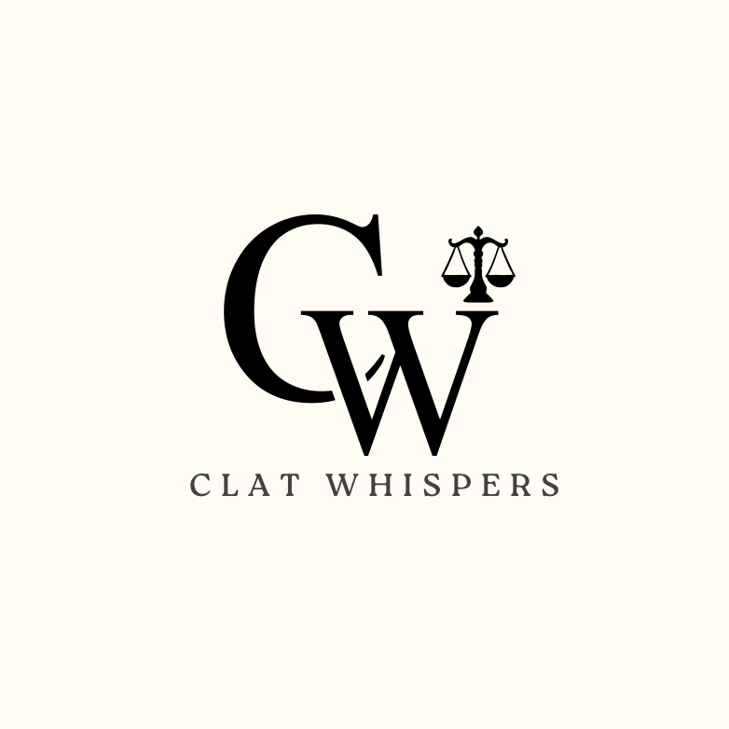
By CLAT WHISPERS

Slide 2
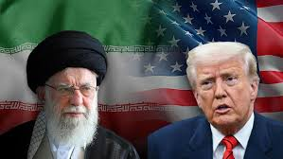
Introduction
The conflict between the United States and Iran is a long-standing geopolitical struggle shaped by ideological clashes, power politics, and regional rivalries. Over the decades, tensions have flared through diplomatic breakdowns, proxy wars, nuclear disputes, and targeted military actions. In recent developments, U.S. airstrikes on Iranian nuclear sites have reignited fears of a broader confrontation. While Washington claims strategic success, Iran remains resolute—continuing its nuclear program and warning of potential escalation, especially with Israel. This presentation explores the current phase of the conflict, its global implications, and the uncertain road ahead.

Slide 3
Background & Historical Context
1953: US-backed coup against PM Mossadegh: The CIA and British intelligence orchestrated Operation Ajax, overthrowing Iran’s democratically elected Prime Minister Mohammad Mossadegh after he nationalised the oil industry. The Shah was reinstalled, deepening Iranian resentment toward Western interference.
1979: Iranian Revolution & US Embassy Hostage Crisis: The Shah was overthrown by a popular Islamic revolution led by Ayatollah Khomeini. Later that year, Iranian students stormed the US embassy in Tehran, taking 52 Americans hostage for 444 days. This marked the beginning of overt hostility between the two nations.
1980–88: Iran–Iraq War (US supported Iraq): During the brutal eight-year war between Iran and Saddam Hussein’s Iraq, the US backed Iraq, supplying intelligence and dual-use materials. Iran suffered immense casualties, further fueling anti-American sentiment.
2000s–2015: Nuclear Dispute; Sanctions & Diplomacy: Concerns over Iran’s nuclear program led to severe UN and US-led sanctions. Diplomacy gained traction in the late 2000s, with the Obama administration leading negotiations.

Slide 4
2015: JCPOA Signed: The Joint Comprehensive Plan of Action (JCPOA), or Iran Nuclear Deal, was signed between Iran and six world powers. It limited Iran’s nuclear activities in exchange for sanctions relief. Seen as a diplomatic breakthrough.
2018: US Withdrawal from JCPOA: President Donald Trump unilaterally withdrew from the deal and reimposed sanctions under a "maximum pressure" campaign. Iran gradually breached the deal’s limits in response.
2020: Qasem Soleimani Killed by US Drone Strike: The US assassinated Major General Qasem Soleimani, head of Iran’s Quds Force, in Baghdad. Iran retaliated by attacking US bases in Iraq, escalating tensions dangerously close to war.
2022–24: Proxy Escalations & Nuclear Enrichment Resumes: Iran-backed groups intensified attacks on US interests in Iraq, Syria, and the Gulf. Iran also resumed high-level uranium enrichment, reducing IAEA oversight, and raising fears of a nuclear breakout. Tensions remained high amid regional instability.

Slide 5
Operation Midnight Hammer – July 2025
A covert yet high-impact US airstrike campaign targeting key Iranian nuclear facilities, launched in July 2025 amid rising nuclear tensions and proxy escalations.
Key Targets & Impact
Fordow Facility (underground, fortified): Heavily damaged, believed to be the main site of advanced uranium enrichment.
Natanz: Targeted but sustained limited damage; Iran had dispersed much of its equipment.
Isfahan: Largely unaffected, minor structural harm reported.
Stated Objectives
Delay or cripple Iran’s nuclear breakout capability
Avoid triggering an all-out regional war, especially with Hezbollah and regional militias
Send a strategic warning to both Iran and its allies (e.g., Russia, China)

Slide 6
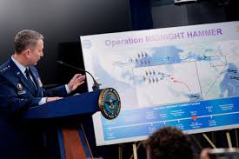
Official U.S. Position on the Operation
U.S. declared the operation a success, claiming key objectives were met.
Stated aim: cripple Iran’s nuclear enrichment capabilities.
Fordow facility reportedly "heavily damaged" by precision strikes.
U.S. claimed limited civilian impact and no intent to escalate to full war.
White House and Pentagon said Iran’s enrichment capacity was obliterated.
Independent verification is limited due to restricted media and IAEA access.
Iran denies major damage, calling U.S. claims exaggerated.
Credibility of U.S. claims questioned internationally in absence of evidence.

Slide 7
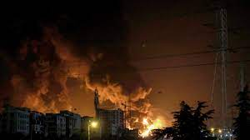
Doubts Emerge Over Impact
New intelligence reports (Al Jazeera, Washington Post) reveal that only Fordow sustained decisive damage, while Natanz and Isfahan remain largely intact or were quickly repairable.
The overall disruption to Iran’s nuclear program may be temporary rather than strategic.
U.S. Senate Democrats, cited by CBS News, have accused the Pentagon of promoting a “misleading” narrative, overstating the mission’s success.
They argue that the actual setback to Iran’s program may last just months, not years as claimed, raising concerns about transparency and long-term effectiveness.

Slide 8
Iran’s Response
President Masoud Pezeshkian, in a televised statement (Al Jazeera, July 23), declared Iran is “ready for war” with Israel if provoked, framing the U.S. strikes as an act of aggression.
He firmly stated that uranium enrichment would continue, rejecting any rollback of Iran’s nuclear ambitions.
Key Quotes reflect Iran’s defiance:
  “Nuclear capability lives in our scientists, not in cement,” implying that airstrikes cannot erase Iran’s nuclear knowledge.
  “We are not backing down — not from Israel, not from Washington,” signaling an uncompromising stance and readiness to escalate if necessary.
The tone suggests a strategic shift from restraint to resistance, aiming to project strength both domestically and regionally.

Slide 9
Iran’s Position on Diplomacy
Foreign Minister Abbas Araghchi stated that Iran remains open to dialogue, but only on “win–win terms”, rejecting pressure-based negotiations.
He emphasized that uranium enrichment is a non-negotiable sovereign right, rooted in national pride and scientific autonomy.
In its strategic messaging, Iran made clear it will not accept any new deal resembling a JCPOA 2.0 if it requires major Iranian concessions without guaranteed, reciprocal benefits.
The position reflects a firm diplomatic posture, aiming to resist Western leverage while keeping negotiation channels technically open.

Slide 10
Regional Dynamics
Israel’s Role:
Allegedly involved in covert coordination with the U.S. during Operation Midnight Hammer, though not officially confirmed.
Iran accuses Israel of orchestrating an assassination attempt on President Pezeshkian during the June 2025 clashes, heightening bilateral tensions.
Proxy Activity:
Iran-backed militias in Iraq, Syria, and Yemen remain highly active, escalating threats against U.S. bases and Israeli-linked targets.
Tehran has signaled potential regional retaliation, warning that both Israeli and American assets may face attacks if provocations continue.
These dynamics suggest a shift toward asymmetric warfare and indirect conflict, with risks of wider destabilization in the Middle East.

Slide 11
Global Implications
Oil Prices: Fears over potential Iranian retaliation in the Strait of Hormuz—a vital oil chokepoint—have caused global oil prices to surge, raising concerns about energy security and inflation worldwide.
Global Security: The strike has heightened fears of a broader regional spillover, with Gulf states, Israel, and U.S. military bases on alert. Escalation could destabilize the entire Middle East.
Non-Proliferation Crisis: The crisis has undermined the credibility of global non-proliferation mechanisms. The UN and IAEA are struggling to assert authority as Iran resists inspections and enrichment oversight.
Middle Power Diplomacy: Nations like China, Russia, and the EU are positioning themselves as potential mediators, calling for restraint and diplomatic solutions to prevent further conflict and salvage arms control frameworks.

Slide 12
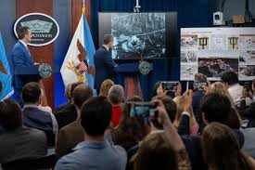
Current Ceasefire Efforts
A Crisis Group report (July 2025) reveals that an informal ceasefire has been quietly brokered between the U.S., Israel, and Iran with the mediation of Oman and Qatar, known for their neutral diplomatic roles.
The Three-Point Plan includes:
  No further strikes by the U.S. or Israel, aiming to de-escalate immediate military tensions.
  Iran agrees to pause visible escalation, including limiting proxy attacks and missile drills.
  Backchannel nuclear talks quietly resume, focused on confidence-building rather than a formal agreement like the JCPOA.

Slide 13
What Lies Ahead?
Renewed Talks
  Diplomatic negotiations could resume, mediated by Europe, Oman, or China, focusing on incremental trust-building rather than a full JCPOA revival.
  Likely to involve limited enrichment caps, sanctions relief discussions, and regional de-escalation measures.
Escalation
  Risk of proxy retaliation by Iran-backed groups or a preemptive Israeli strike if Iran resumes visible nuclear activity.
  Could trigger a broader regional conflict, drawing in U.S. forces and destabilizing Gulf security.
Cold Peace
  A prolonged low-intensity standoff, where both sides avoid direct conflict but maintain hostile rhetoric, cyberattacks, and proxy operations.
  No diplomatic breakthrough, but also no immediate war — a fragile and unstable status quo.

Slide 14
Conclusion
The U.S. airstrikes under Operation Midnight Hammer delivered a tactical blow but fell short of decisively halting Iran’s nuclear ambitions, which remain firmly intact. Iran’s defiant stance, coupled with active proxy networks, has kept regional tensions high and unpredictable. While the situation remains volatile, especially with Israeli involvement and oil market instability, the emergence of informal ceasefire channels and renewed backdoor diplomacy suggests that a new, more balanced diplomatic framework—though fragile—remains a possibility.

Slide 15
THANK
YOU!

