Slide 1
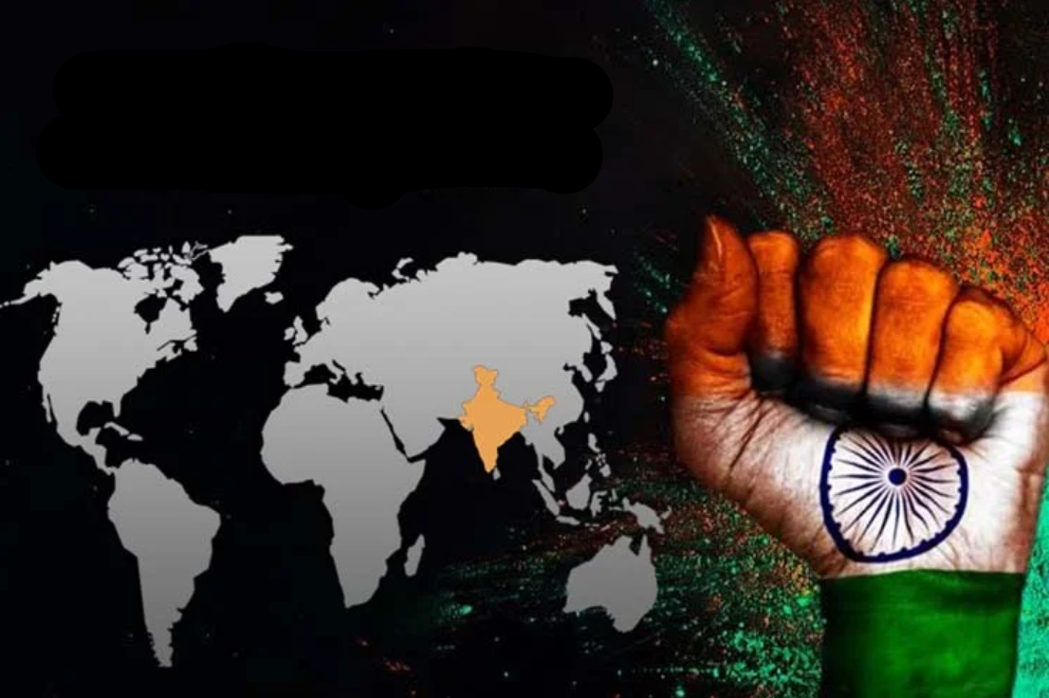
INDIA’S INTERNATIONAL TREATIES
By CLAT WHISPERS

Slide 2


Introduction
India, as one of the world’s largest democracies and a prominent player in global affairs, has consistently engaged with the international community through participation in numerous treaties and conventions. Across diverse domains such as trade, environment, human rights, nuclear regulation, and regional cooperation, India has demonstrated its commitment to multilateralism and global governance. By becoming a signatory or a party to several significant international treaties, India seeks not only to protect and promote its national interests but also to contribute to the development of an equitable and sustainable international order. These treaties reflect India’s evolving role in the global arena and its dedication to upholding international law, fostering global partnerships, and addressing transnational challenges in collaboration with other nations.

Slide 3

Trade and Economic Treaties
Trade and economic treaties are formal agreements between countries aimed at promoting trade, investment, and economic cooperation. These treaties can be multilateral, regional, or bilateral, and typically address key areas such as tariff reduction, improved market access, investment protection, intellectual property rights, and dispute resolution.
For a developing country like India, such agreements are crucial for expanding its global trade presence, attracting foreign direct investment, encouraging domestic economic reforms, and supporting long-term economic growth through stable and predictable international trade relations.

Slide 4
India’s Trade and Economic Treaties
1. General Agreement on Tariffs and Trade (GATT) (1947) and World Trade Organization (WTO) Agreement (1995): GATT was a multilateral agreement established in 1947 to reduce tariffs and other trade barriers. India was a founding member and actively participated in its rounds of negotiations. In 1995, the World Trade Organization (WTO) replaced GATT as a more structured and comprehensive body to regulate international trade, to which India is also a founding member. The WTO framework governs trade in goods, services, and intellectual property, and provides a dispute settlement mechanism.
2. South Asian Free Trade Area (SAFTA): SAFTA is a regional trade agreement signed in 2004 under the South Asian Association for Regional Cooperation (SAARC), aiming to promote and sustain mutual trade and economic cooperation among South Asian countries. It came into force in 2006 and includes members like India, Pakistan, Bangladesh, Nepal, Bhutan, Sri Lanka, Maldives, and Afghanistan. The agreement seeks to reduce customs duties on traded goods among member countries and enhance regional integration.

Slide 5
3. Comprehensive Economic Cooperation Agreements (CECA): CECAs are broad-based agreements that include trade in goods, services, investment, and economic cooperation. India has signed CECAs with countries such as Singapore (2005) and Malaysia (2011). These agreements provide preferential access to markets and aim to deepen economic ties by addressing not just tariffs but also regulatory and structural issues impacting trade.
4. Bilateral Investment Treaties (BITs): BITs are agreements between two countries designed to promote and protect investments by investors from each country in the other's territory. India has signed BITs with over 80 countries, although many were reviewed or terminated in recent years to draft a new model BIT in 2016. These treaties provide protection against expropriation, ensure fair and equitable treatment, and include mechanisms for dispute resolution.
5. Asia-Pacific Trade Agreement (APTA): APTA, formerly known as the Bangkok Agreement, is a preferential trade agreement among countries in the Asia-Pacific region. India is a member along with China, South Korea, Bangladesh, Sri Lanka, and Laos. APTA aims to promote economic development through trade liberalization and offers tariff concessions on a range of goods. It also facilitates cooperation in areas such as trade facilitation and investment.

Slide 6

Environmental and Climate Treaties
Environmental and climate treaties are international agreements aimed at addressing global environmental challenges such as climate change, biodiversity loss, pollution, and the degradation of ecosystems. These treaties establish shared goals, legal obligations, and cooperative mechanisms among countries to protect the environment and promote sustainable development. For India, which faces both the pressures of development and environmental vulnerability, such treaties are critical in balancing growth with ecological responsibility and participating in global climate action.

Slide 7
India’s Environmental and Climate Treaties
1. Paris Agreement (2015) – Under the UNFCCC: The Paris Agreement is a landmark international treaty under the UN Framework Convention on Climate Change (UNFCCC) that aims to limit global warming to well below 2°C, ideally 1.5°C, above pre-industrial levels. India, as a signatory, has committed to reducing emissions intensity, expanding renewable energy, and enhancing climate resilience.
2. Kyoto Protocol: Adopted in 1997 under the UNFCCC, the Kyoto Protocol set binding targets for developed countries to reduce greenhouse gas emissions. Though developing countries like India were exempt from emission reduction commitments, India supported the principle of "common but differentiated responsibilities."
3. Convention on Biological Diversity (CBD): The CBD, adopted in 1992, aims to conserve biological diversity, ensure sustainable use of natural resources, and promote fair sharing of benefits from genetic resources. India, being a megadiverse country, has been an active participant in implementing the CBD's goals through national biodiversity strategies.

Slide 8

4. Ramsar Convention on Wetlands: This 1971 convention focuses on the conservation and sustainable use of wetlands. India is a party to the Ramsar Convention and has designated over 75 Ramsar sites, recognizing their ecological importance and the need to preserve wetland ecosystems.
5. Convention on International Trade in Endangered Species (CITES): CITES aims to ensure that international trade in wild animals and plants does not threaten their survival. India, as a member, regulates the trade of endangered species through a licensing system and strict enforcement measures under domestic wildlife laws.
6. Montreal Protocol: Signed in 1987, the Montreal Protocol seeks to phase out the production and consumption of ozone-depleting substances (ODS). India has successfully complied with its commitments under the protocol and is transitioning to safer alternatives to protect the ozone layer.

Slide 9

Human Rights and Social Justice Treaties
Human rights and social justice treaties are international legal instruments that aim to protect the fundamental rights and dignity of individuals and groups across all nations. These treaties obligate states to uphold civil, political, economic, social, and cultural rights without discrimination. They serve as frameworks for promoting equality, protecting vulnerable populations, and ensuring access to justice, education, healthcare, and participation in public life. For India, as a democratic and diverse nation, ratifying and implementing such treaties reflects its constitutional values and commitment to global human rights standards. They also guide national legislation, shape welfare policies, and strengthen institutional accountability in promoting inclusive and just development.

Slide 10
India’s Human Rights and Social Justice Treaties
1. International Covenant on Civil and Political Rights (ICCPR): The ICCPR, adopted in 1966, guarantees rights such as freedom of speech, religion, assembly, and fair trial. India ratified the covenant in 1979, aligning with its constitutional protections of civil and political liberties.
2. International Covenant on Economic, Social and Cultural Rights (ICESCR): Also adopted in 1966, the ICESCR recognizes rights related to work, education, health, and an adequate standard of living. India, as a party, is obligated to progressively realize these rights through appropriate legislation and policy.
3. Convention on the Elimination of All Forms of Discrimination Against Women (CEDAW): CEDAW, adopted in 1979, seeks to eliminate discrimination against women in all spheres of life, including education, employment, and political participation. India ratified it in 1993 and has since taken legislative steps to advance gender equality.

Slide 11

4. Convention on the Rights of the Child (CRC): The CRC, adopted in 1989, affirms children's rights to survival, development, protection, and participation. India ratified the CRC in 1992 and has enacted several laws and schemes focused on child welfare and protection.
5. Convention on the Rights of Persons with Disabilities (CRPD): Adopted in 2006, the CRPD promotes the rights and dignity of persons with disabilities. India ratified the convention in 2007 and passed the Rights of Persons with Disabilities Act, 2016 to align domestic law with its obligations under the treaty.

Slide 12
Disarmament and Security Treaties
Disarmament and Security Treaties are formal agreements between nations that aim to reduce or eliminate specific categories of weapons, particularly those that pose serious threats to global peace and human security. These treaties are essential instruments of international law and diplomacy, designed to curb the arms race, promote strategic stability, and prevent the outbreak of armed conflicts. Disarmament treaties primarily focus on weapons of mass destruction (WMDs) such as nuclear, chemical, and biological weapons, which can cause large-scale devastation and civilian casualties. They seek not only to prohibit the production and use of such weapons but also to ensure their destruction and prevent their proliferation.
On the other hand, security treaties often address conventional weapons, military conduct, and regional or thematic concerns like the protection of civilians in armed conflict, non-aggression pacts, and the peaceful use of emerging technologies. These agreements play a vital role in building mutual trust among states, fostering transparency, and encouraging cooperation on verification, compliance, and crisis prevention.

Slide 13
India’s Disarmament and Security Treaties
1. Biological Weapons Convention (BWC): Adopted in 1972, the BWC is the first multilateral treaty to ban an entire category of weapons—biological and toxin weapons. It prohibits the development, production, and stockpiling of biological agents for hostile purposes while allowing their use for peaceful research. Although it lacks a strong verification mechanism, the BWC represents a crucial step in preventing the use of biological warfare globally.
2. Chemical Weapons Convention (CWC): Signed in 1992, the CWC outlaws the production, stockpiling, and use of chemical weapons. It is enforced by the Organisation for the Prohibition of Chemical Weapons (OPCW), which carries out inspections and ensures compliance. The treaty is comprehensive and includes strict timelines for the destruction of chemical weapon stockpiles, promoting global chemical disarmament.
3. Convention on Certain Conventional Weapons (CCW): Adopted in 1980, the CCW seeks to limit the use of conventional weapons that are considered excessively injurious or have indiscriminate effects, such as landmines, booby traps, and incendiary weapons. It aims to balance humanitarian concerns with military necessity, offering protections especially to civilians and combatants in armed conflict.

Slide 14
4. Convention on Nuclear Safety: Entered into force in 1994, this treaty focuses on the safety of civilian nuclear power plants. It obliges member states to maintain high safety standards, regularly report on safety measures, and undergo peer reviews. The goal is to prevent nuclear accidents like Chernobyl or Fukushima and promote transparency and international cooperation in nuclear energy management.
5. Non-Nuclear Aggression Agreement (India–Pakistan, 1988): This bilateral agreement between India and Pakistan, signed in 1988, is aimed at preventing attacks on each other’s nuclear installations and facilities. As a confidence-building measure, both countries annually exchange lists of their nuclear installations and refrain from targeting them in conflicts. It helps reduce nuclear tensions in the South Asian region.
6. Outer Space Treaty (1967): This foundational treaty on space law ensures that outer space is used only for peaceful purposes. It prohibits the placement of nuclear weapons or any WMDs in orbit or on celestial bodies, and restricts military activities in outer space. It promotes international cooperation, peaceful exploration, and holds states responsible for national space activities, whether governmental or private.

Slide 15

Regional and Bilateral Treaties
Regional and bilateral treaties are agreements made between two or more neighboring or geographically connected states to address specific issues such as border demarcation, water-sharing, trade, security, or cultural cooperation. While regional treaties may involve multiple countries within a geographic region, bilateral treaties are specifically between two countries. These treaties play a crucial role in strengthening diplomatic relations, resolving long-standing disputes, and promoting regional stability and mutual development. They often reflect shared history, interdependence, and the need for cooperative frameworks to manage resources, boundaries, and strategic interests.

Slide 16
India’s Regional and Bilateral Treaties
1. Indus Waters Treaty – with Pakistan (1960): Signed in 1960 and brokered by the World Bank, the Indus Waters Treaty is a water-sharing agreement between India and Pakistan. It allocates control over the six rivers of the Indus basin: Pakistan received rights to the western rivers (Indus, Jhelum, and Chenab), while India retained rights over the eastern rivers (Ravi, Beas, and Sutlej). Despite tensions and wars, this treaty is considered one of the most successful examples of water cooperation between two rival states.
2. India–Bangladesh Land Boundary Agreement (LBA) – 2015: Originally signed in 1974 and ratified in 2015, this landmark agreement between India and Bangladesh resolved long-standing border disputes and exchanged 162 enclaves (Indian enclaves in Bangladesh and vice versa). The agreement facilitated the granting of citizenship to over 50,000 stateless people and improved border management and relations between the two countries. It is hailed as a major diplomatic success in South Asia.

Slide 17
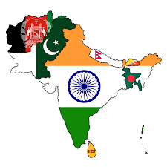
3. India–Sri Lanka Maritime Boundary Agreements (1974, 1976): These two agreements, signed in 1974 and 1976, demarcated the maritime boundary between India and Sri Lanka in the Gulf of Mannar and Palk Strait. The treaties were intended to clarify territorial waters, avoid conflicts over fishing rights, and facilitate maritime cooperation. They also included the transfer of the Kachchatheevu island to Sri Lanka, which remains a politically sensitive issue in India.
4. Mahakali Treaty – with Nepal (1996): The Mahakali Treaty, signed in 1996 between India and Nepal, governs the integrated development of the Mahakali River, which forms part of the western border between the two countries. It includes provisions for sharing water, building hydroelectric projects (like Pancheshwar Multipurpose Project), and ensuring equal benefits in terms of irrigation and power. Despite delays in implementation, it symbolizes mutual commitment to shared water resources and regional development.

Slide 18

Intellectual Property and Technology Treaties
Intellectual Property (IP) and Technology Treaties are international legal agreements that regulate the protection, recognition, and enforcement of intellectual property rights across countries. These treaties aim to create a harmonized legal framework to promote creativity, innovation, and fair competition in global markets. IP treaties cover areas such as patents, copyrights, trademarks, industrial designs, and trade secrets. They are especially important in today’s globalized, knowledge-based economy, where inventions, literary works, and technological developments often cross national borders. By providing legal certainty and protection to creators and inventors, these treaties encourage investment, research, and international collaboration.

Slide 19

India’s Intellectual Property and Technology Treaties
1. Patent Cooperation Treaty (PCT): The PCT, adopted in 1970 and managed by WIPO, allows inventors to file a single patent application that can be recognized in over 150 countries. It streamlines the international patent process, giving applicants more time and flexibility to pursue protection in different jurisdictions. Although it does not grant a global patent, it reduces duplication and delays, making international patenting more accessible.
2. Berne Convention for the Protection of Literary and Artistic Works: The Berne Convention, first adopted in 1886, protects the rights of authors and creators over their literary and artistic works across all member countries. It ensures automatic copyright protection without the need for registration and grants moral and economic rights to creators. It upholds the principle that foreign authors receive the same legal protection as nationals.

Slide 20

3. TRIPS Agreement (Trade-Related Aspects of Intellectual Property Rights): The TRIPS Agreement, signed in 1994 under the WTO framework, sets global standards for the protection and enforcement of intellectual property rights. Covering areas such as patents, copyrights, and trademarks, it links IP rights with trade law. TRIPS also includes provisions to balance IP enforcement with public interests, like access to medicines and technology transfer.

Slide 21

Labour and Social Protection Treaties
Labor and Social Protection Treaties are international agreements that set minimum standards for workers' rights, workplace conditions, and social protections. These treaties, primarily developed and monitored by the International Labour Organization (ILO), aim to promote decent work, equality, safety, and human dignity for all workers. They focus on eliminating exploitation, ensuring fair wages, prohibiting forced and child labor, and upholding fundamental labor rights. Such treaties are essential for fostering inclusive economic growth and social justice, particularly in the context of globalization and the growing informal workforce.

Slide 22

India’s Labour and Social Protection Treaties
1. Equal Remuneration Convention (ILO), 1951 (No. 100): This convention calls for equal pay for men and women for work of equal value. It aims to eliminate gender-based wage discrimination and ensure fairness in employment. Ratifying countries are required to promote equal remuneration through laws, collective bargaining, or wage assessment practices. The convention is a key instrument in promoting gender equality in the labor market.
2. Forced Labour Convention, 1930 (No. 29): Adopted by the ILO in 1930, this convention prohibits all forms of forced or compulsory labor, except under specific circumstances like military service or civic duties. It defines forced labor as work extracted under the threat of penalty and not undertaken voluntarily. The treaty is fundamental to the fight against human trafficking, modern slavery, and coercive labor practices.

Slide 23
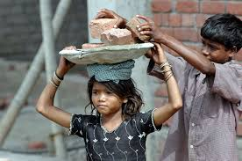
3. Minimum Age Convention, 1973 (No. 138): This convention sets the minimum age for admission to employment or work, aiming to abolish child labor. It requires ratifying countries to set a minimum age (not less than the age of completion of compulsory schooling) and to develop a national policy to eliminate child labor gradually. The convention is vital in protecting children's rights and ensuring access to education.
4. Worst Forms of Child Labour Convention, 1999 (No. 182): This convention targets the most exploitative forms of child labor, including slavery, child trafficking, forced labor, sexual exploitation, and work harmful to health and morals. It urges immediate action to prohibit and eliminate these worst forms. Widely ratified, it reinforces global commitment to ending severe exploitation of children.

Slide 24
Conclusion
India's participation in a broad range of international treaties reflects its commitment to global cooperation, sustainable development, peace, and justice. From trade and environmental protection to human rights and disarmament, these treaties shape India's domestic laws, foreign policy, and international standing. As a democratic nation with a growing global presence, India's ratification and implementation of these treaties demonstrate its willingness to align with international norms while also safeguarding its national interests. Going forward, India's role in international treaty law will continue to evolve, especially as it navigates emerging global challenges and asserts itself as a key player in international governance.

Slide 25
THANK YOU

