Slide 1
HUSH MONEY CASE
Examining Legal, Political, and Historical Dimensions
By CLAT WHISPERS

Slide 2

Overview of the Hush Money Case
What Happened: Donald Trump sentenced in the New York "Hush Money" case.
Verdict: Unanimous jury found Trump guilty of 34 felony counts of falsifying business records.
Involved Parties: Stormy Daniels (adult film star), Michael Cohen (Trump's lawyer and fixer).
Allegations: $130,000 payment to Daniels for silence regarding an alleged affair before the 2016 election.
Significance: Seen as election interference.

Slide 3
Timeline of Events:
2006-2007: Trump allegedly has affairs with Stormy Daniels and Karen McDougal, according to both women.
2016 Presidential Election:
October 2016: Just weeks before the election, Daniels was paid $130,000 in exchange for her silence about the alleged affair. The payment was made by Michael Cohen, who claimed it was for personal reasons, not related to the campaign.
August 2016: McDougal was paid $150,000 by the National Enquirer for her story, but the story was never published. This payment, known as a "catch and kill" deal, was intended to prevent her from speaking out during the election campaign.
2018: Cohen admitted in a federal court that he had paid Daniels at Trump’s direction to suppress the story, asserting that the payment was made to influence the election, a violation of federal campaign finance laws.
April 2018: Cohen publicly pleaded guilty to multiple charges, including campaign finance violations related to the hush money payments. He also confessed to lying to Congress about the timing of the payments.

Slide 4
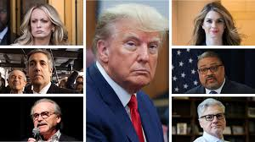
Key Players:
Stormy Daniels (Stephanie Clifford) – An adult film actress who claimed to have had an affair with Trump in 2006. In 2018, Daniels sued to have a non-disclosure agreement (NDA) she signed in 2016 declared invalid, claiming it was meant to silence her.
Karen McDougal – A former Playboy model who claimed she had an affair with Trump in 2006. She was paid $150,000 by the National Enquirer in a "catch and kill" deal to suppress her story before the 2016 election.

Slide 5
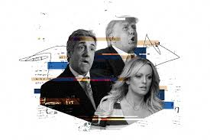
Michael Cohen – Trump’s personal attorney who arranged the payments to Daniels and McDougal. He later admitted to violating campaign finance laws by making these payments at Trump’s direction. Cohen pleaded guilty to multiple crimes, including tax evasion, lying to Congress, and campaign finance violations.
Donald Trump – The 45th President of the United States, who denied having had affairs with either Daniels or McDougal and initially denied knowing about the payments, before later admitting to reimbursing Cohen for the payment to Daniels.

Slide 6
Broader Context – Trump’s Impeachments and Legal Issues
Impeachment History:
Trump impeached twice during his presidency (2019, 2021).
First impeachment: Abuse of power and obstruction of Congress (Ukraine scandal).
Second impeachment: Incitement of insurrection (Capitol riot).
Connection to Hush Money Case: Reflects broader concerns about ethical conduct and abuse of power

Slide 7
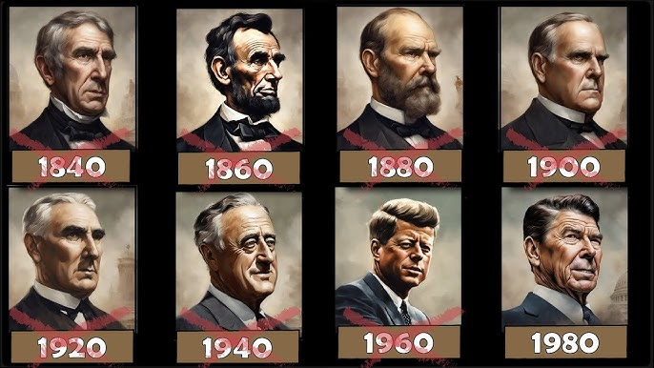
Assassination and Impeachment of US Presidents
Presidents Assassinated:
Abraham Lincoln (1865): John Wilkes Booth.
James Garfield (1881): Charles Guiteau.
William McKinley (1901): Leon Czolgosz.
John F. Kennedy (1963): Lee Harvey Oswald.
Impeached Presidents:
Andrew Johnson (1868): Acquitted.
Bill Clinton (1998): Acquitted.
Donald Trump: Twice impeached and acquitted.
Attempts on Presidents:
Ronald Reagan (1981): Survived an assassination attempt by John Hinckley Jr.
Theodore Roosevelt: Survived a shot while giving a speech.

Slide 8
Procedure for Impeachment of US Presidents
Initiation: Allegations of misconduct are presented in the House of Representatives (not "House of Parliament," as the U.S. does not have a Parliament). These allegations are formalized into Articles of Impeachment, which outline the charges, such as "high crimes and misdemeanors.“
Investigation: The House investigates the charges through hearings and inquiries. If evidence supports the allegations, the House Judiciary Committee drafts specific Articles of Impeachment for a vote.
House Vote and Resolution: The House of Representatives votes on the Articles of Impeachment. A simple majority (more than 50%) is required to impeach the President, officially moving the process to the Senate.
Senate Trial and Finality: The Senate conducts a trial, presided over by the Chief Justice of the Supreme Court. The Senate votes after hearing arguments from both sides. A two-thirds majority (67 out of 100 votes) is required to convict and remove the President. If convicted, the President is removed from office and may be barred from holding future public office.

Slide 9
Procedure for Impeachment of Indian Presidents
Constitutional Provision: The impeachment process for the President is outlined in Article 61 of the Indian Constitution.
Grounds for Impeachment: The President can be impeached for violating the Constitution.
Procedure:
  A resolution for impeachment must be passed by a two-thirds majority in both houses of Parliament (Lok Sabha and Rajya Sabha).
  The resolution is then investigated by a committee.
President’s Defense: The President has the right to defend themselves during the process.
Outcome: If the impeachment motion is passed by both houses, the President is removed from office.
The process is rigorous, ensuring that impeachment is not taken lightly.

Slide 10

The United States Secret Service (USSS)
Primary Role: Protection of the President, Vice President, and their families.
History: Established in 1865 (initially focused on counterfeiting).
Current Responsibilities:
  Protection of key government officials.
  Safeguarding national events (e.g., inaugurations).
  Investigation of financial crimes.
Structure and Operation:
Operates under the Department of Homeland Security (DHS).
Combines intelligence gathering, counterintelligence, and emergency response.

Slide 11
Impact:
Impact on 2020 Presidential Election: The 2016 hush money scandal became a key issue in the 2020 election, with critics claiming that Trump’s actions violated election laws and undermined democratic integrity. The controversy surrounding the payments fueled further scrutiny of Trump’s conduct and raised questions about his adherence to ethical standards, becoming a central talking point during his reelection campaign.
Public Opinion: While Trump’s supporters largely viewed the scandal as a politically motivated attack, the issue contributed to significant legal and political challenges. The scandal impacted public opinion, with some voters concerned about his legal entanglements and others seeing it as an attempt to discredit his presidency. The controversy ultimately played a role in shaping his legacy and political future.

Slide 12
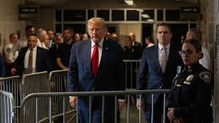
Conclusion:
The hush money case is a major legal challenge for Donald Trump, affecting his personal reputation and political career. It involves payments made to suppress stories of alleged affairs with Stormy Daniels and Karen McDougal during the 2016 election. Despite Trump’s denials, ongoing investigations focus on whether these payments violated campaign finance laws. The case underscores the complexities of campaign finance, particularly regarding undisclosed “in-kind contributions,” and could set important precedents for future candidates. The outcome could impact future election regulations and campaign practices, making it a crucial moment in U.S. political history.

Slide 13
THANK YOU

